Slide 1
8.4
Bond Polarity and Electronegativity

Slide 2
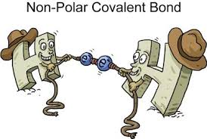
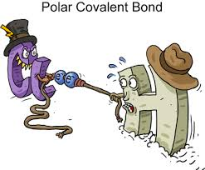
8.4 bOND POLARITY
The distribution of electrons in a molecule or compounds is rarely uniform
described by bond polarity or the degree to which electrons are shared
Quantum mechanical model tells us…
Non polar covalent molecules have equal distribution of the electrons between both atoms
Polar covalent molecules have unequal distribution of electrons where one atom attracts the electrons more creating a dipole

Slide 3
8.4 bOND POLARITY
Electronegativity is defined as the quantitative value that describes an atoms ability to attract electrons
Used to predict whether atoms behave as ionic, polar covalent, or non polar covalent compounds
This is the more sophisticated way to describe the type of bonding present
Use to predict the type of bond, later (in chapter 9) the type of molecule

Slide 4
8.3 Electronegativity
Modern electronegativity table was created by Lewis Pauling, who based his values on thermochemical data
Elements with high ionization energy and negative electron affinity will have high electronegativity
It is useful skill in chemistry to commit to memory that fluorine is the most electro negative element
top right corner of both trends

Slide 5
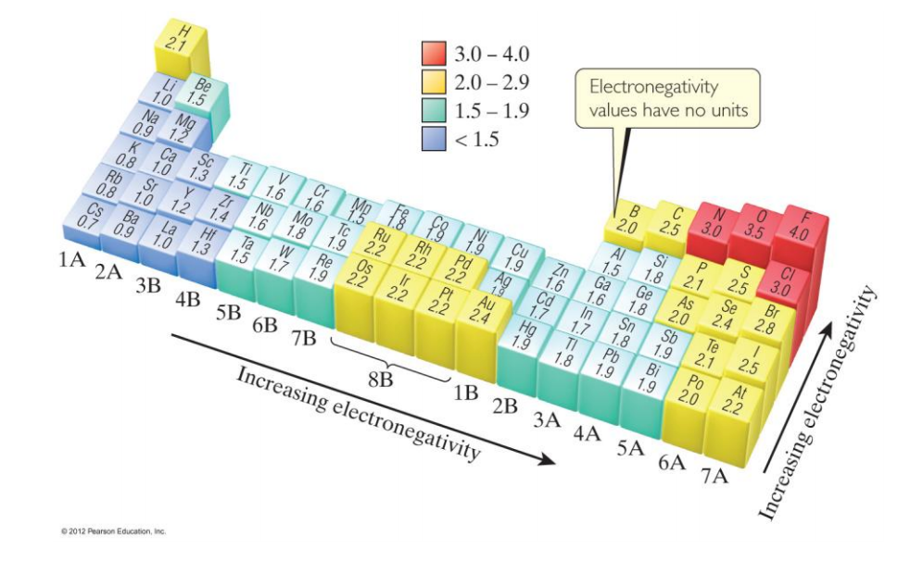
Electronegativity trend

Slide 6
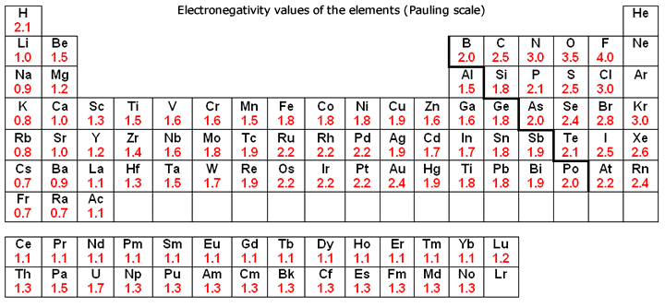
Electronegativity

Slide 7
8.4 Electronegativity and Bond Polarity
For electronegativity, simply subtract the smaller value from the larger value in a bond
The value should be positive and it is unites
Use the table on the following slide to classify the polarity of bonds

Slide 8
8.4 Electronegativity and Bond Type

Slide 9
8.4 Electron density images
In this computer model, red areas identify the areas of high electron density, blue is low, green shows no difference

Slide 10
8.4 Electronegativity and Bond Polarity
Greater differences in electron density imply greater polarity
Large differences in electronegativity create partial positive and negative charges
Polarity or non polarity….
Accounts for properties like solubility, melting point, and conductivity

Slide 11
8.4 polarity practice
Calculate differences in electronegavity and describe the type of bond
F-F
H-O
Al-Cl
Na-Cl

